Slide 1
Chapter 8 Governance of the Internet

Slide 2
Table of Contents
Introduction
The Origins of the Internet
The Internet Protocols (TCP/IP)
Commercialization
Internet Corporation for assigned names and numbers (ICANN)
Do Trademarks Matter in Domain Names?
Domain Trademark Dispute Resolution Process
The future of Internet Governance

Slide 3
Introduction
Governance of the Internet answers these questions?
Who controls access to the entire infrastructure of the Internet and, most relevantly, who controls access to the Web via URLs.
Who decided that Amazon.co.uk and Amazon.com could both exist and point to different servers?
How does a system which was originally designed to connect a few thousand academic and military computers allow the world's biggest information distribution scheme to run?
Can the US president order the Internet shut down?
Who has control and who oversees the exercise of that control of the WWW

Slide 4
The History of Internet

Slide 5
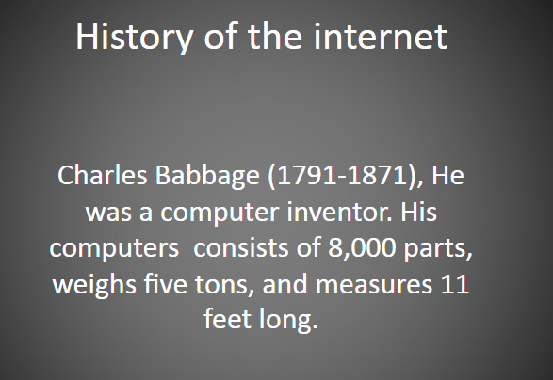
The Origins of the Internet

Slide 6
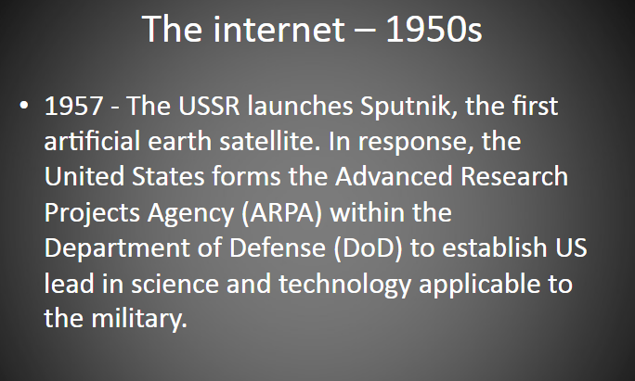
The Origins of the Internet

Slide 7
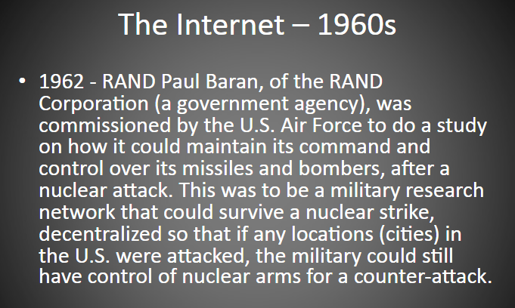
The Origins of the Internet

Slide 8
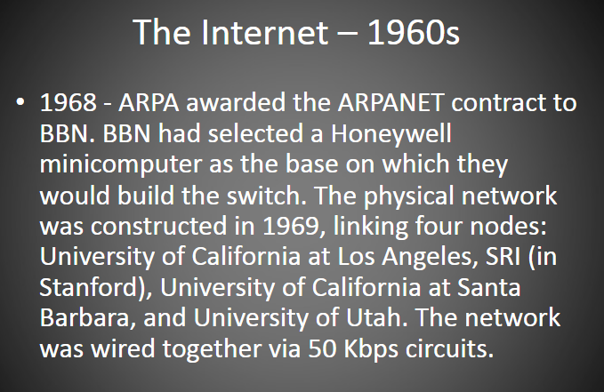
The Origins of the Internet

Slide 9
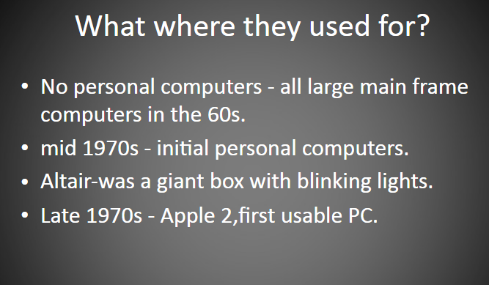
The Origins of the Internet

Slide 10
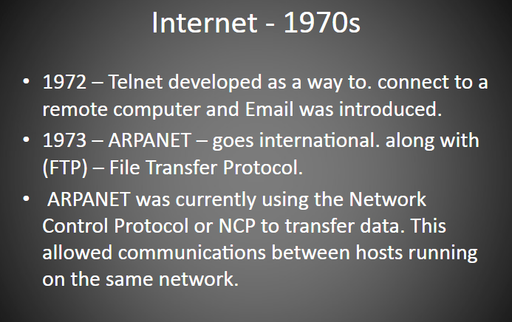
The Origins of the Internet

Slide 11
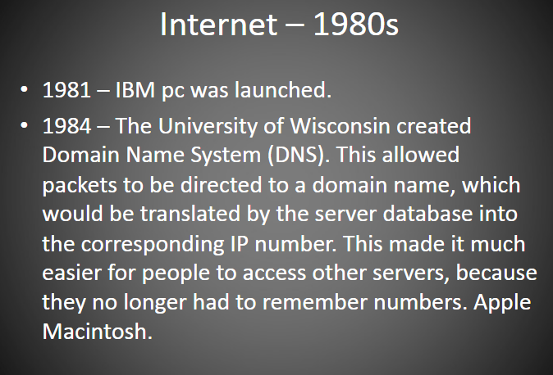
The Origins of the Internet

Slide 12
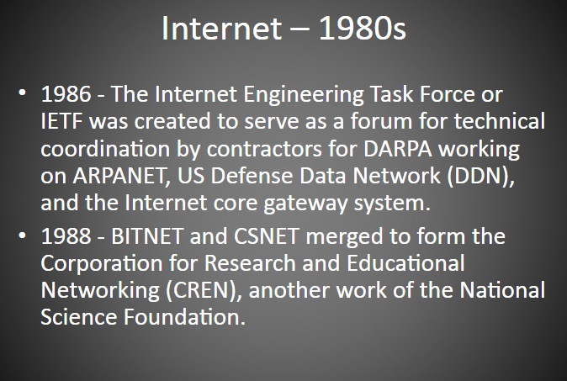
The Origins of the Internet

Slide 13
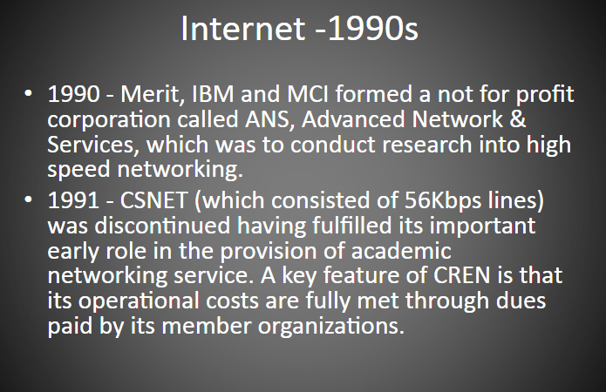
The Origins of the Internet

Slide 14
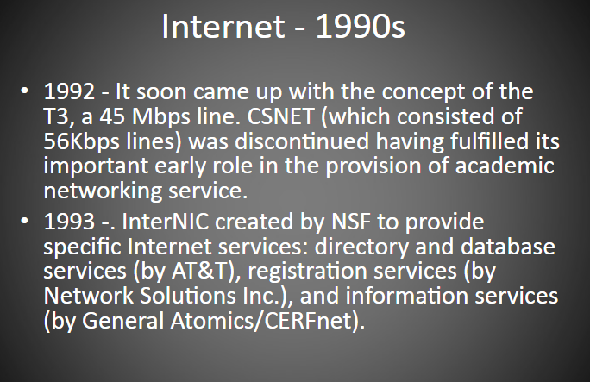
The Origins of the Internet

Slide 15
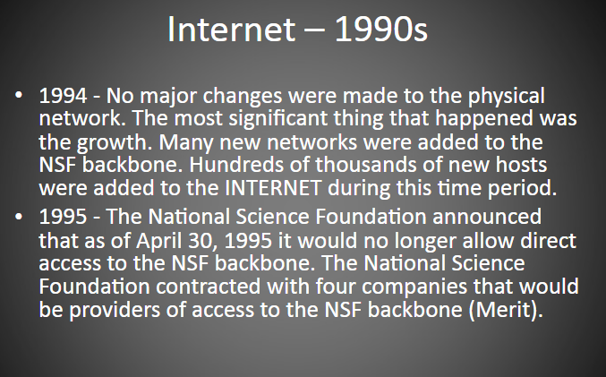
The Origins of the Internet

Slide 16
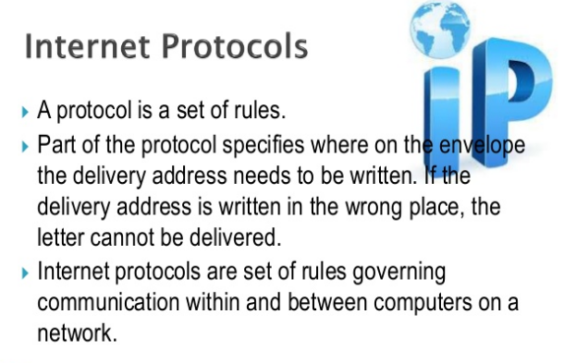
The Internet Protocol

Slide 17
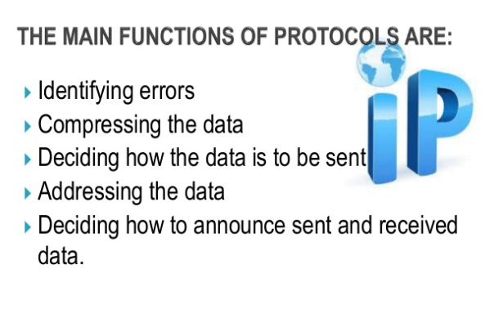
The Internet Protocol

Slide 18
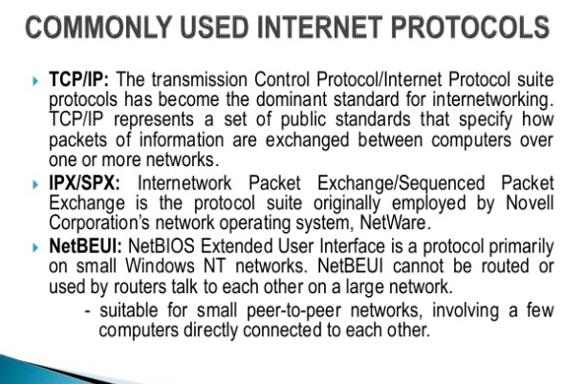
The Internet Protocol

Slide 19
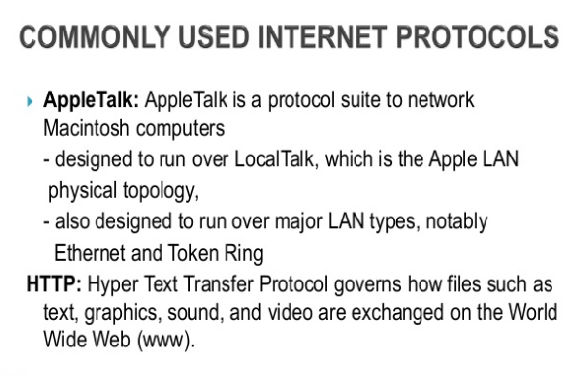
The Internet Protocol

Slide 20
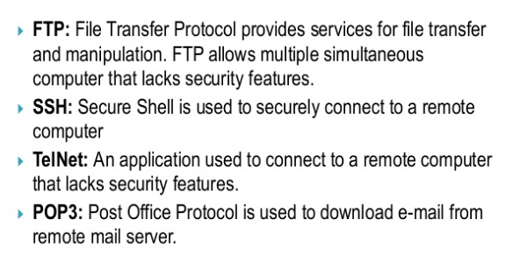
The Internet Protocol

Slide 21
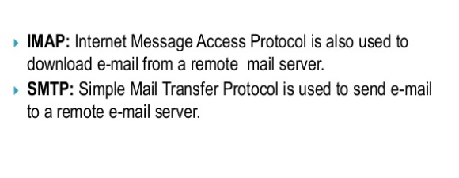
The Internet Protocol

Slide 22
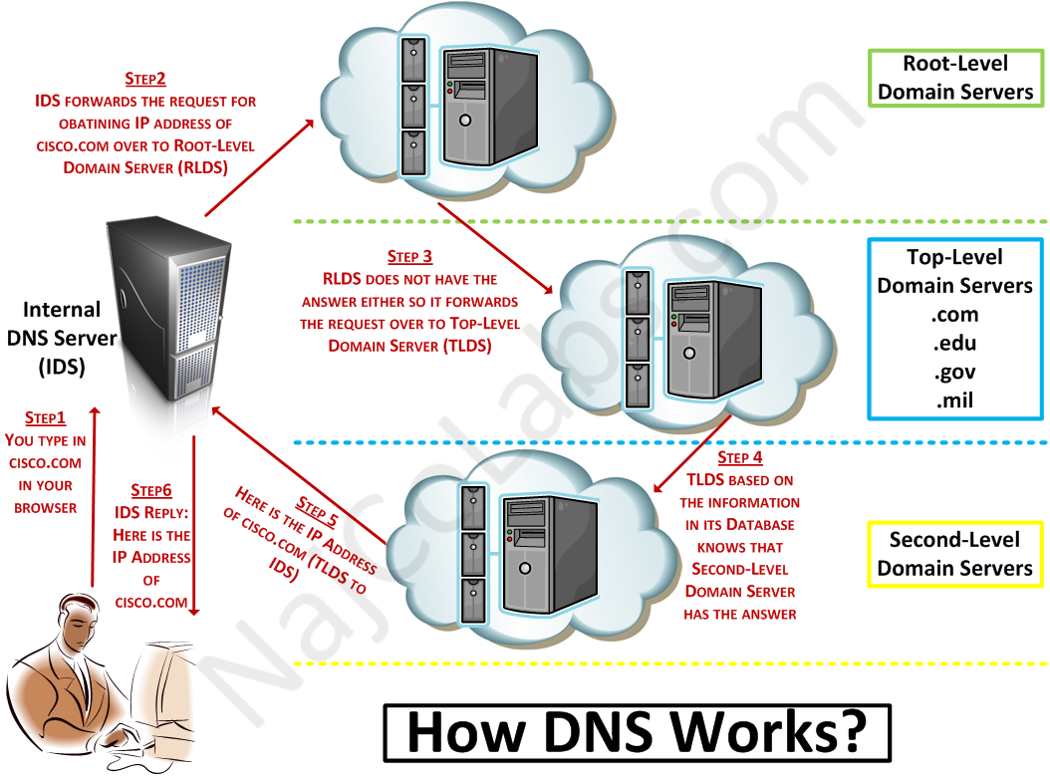
Early Arguments

Slide 23
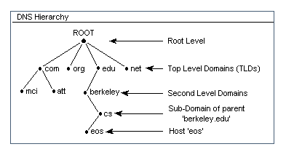
DNS HIERARCHY

Slide 24
Early Arguments
Before discuss the problems with a commercial Internet and the apparent abuse of power by the current domain name controllers, we must differentiate between the different roles played by various organizations in running the infrastructure of the Internet: IANA, IETF and the DNS root
Internet Assigned Numbers Authority (IANA):
assigns blocks of IP addresses to networks.
Internet Engineering Task Force (IETF):
approves changes to the main protocols of the Internet.

Slide 25
DNS Root
DNS root: a server which points to the authoritative server for a particular top-level domain (TLD)
Of course this does not happen every time there is a query because the various levels in the hierarchy cache the results of various requests for a certain length of time and often ‘forward cache’ expected queries

Slide 26
DNS Root
DNS Service:
Big Idea: Power that is granted to the root server: whoever controls the root servers also controls which top-level domains are visible
While this might not seem a great deal to control, it is actually a major issue.
It is also a lever to control other aspects of the domain name system, particularly when a new contract is signed for a top-level domain

Slide 27
DNS Root
E.g. a top-level domain name server would probably have the dns.org address in its cache and might maintain it whenever the copy in the cache is timed out.
This provides quicker service and a robust response to failure of links in the chain

Slide 28
Commercialization
Who controls the root servers that ‘ground’ the domain name server system and why that gives them power?
US company called Network Solutions Incorporated (NSI) had been granted a contract by the US government in 1991 to perform the IANA function for military and civilian use
However, NSI still subcontracted the running of the system to Jon Postel (who ran DNS lookup)

Slide 29
Commercialization
Who controls the root servers that ‘ground’ the domain name server system and why that gives them power?
During the early 1990s, the Internet was opened up to commercial traffic and commercial internet service providers (ISPs) emerged.
These ISP were controlled by telephone companies

Slide 30
Commercialization
Who controls the root servers that ‘ground’ the domain name server system and why that gives them power?
NSI's agreement with the US government allowed NSI to charge the government a fee for registration of subdomains and NSI controlled the top-level domains that existed. These charges were growing exponentially!
Even in these early days the question of who was allowed to register a trademark name in the second level was at issue.
Although how these issues were (and are) dealt with is dependent upon who controls the root, the struggle for control of the root forms the backdrop to the foreground struggle for individual domains

Slide 31
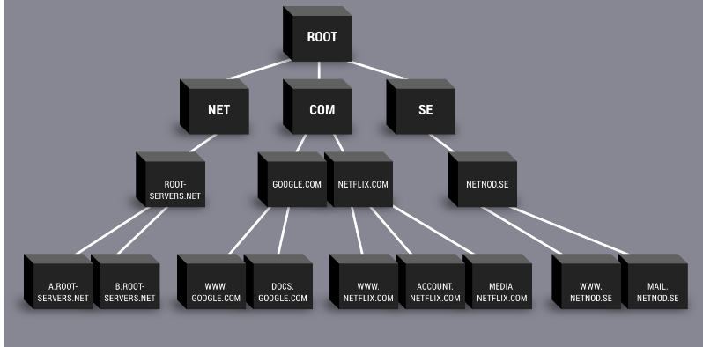
The Root of All Evil

Slide 32
Internet Corporation for Assigned Names and Numbers (ICANN)
Internet Corporation for Assigned Names and Numbers (ICANN): a non-profit organization set up to perform IANA operation
It was obvious the government National Science Foundation) should not be involved

Slide 33
Internet Corporation for Assigned Names and Numbers
3 major players in the struggle for control of the root at this point:
the US Department of Commerce
ISOC and the international Council of Registrars (CORE)
Network Solutions Inc.

Slide 34
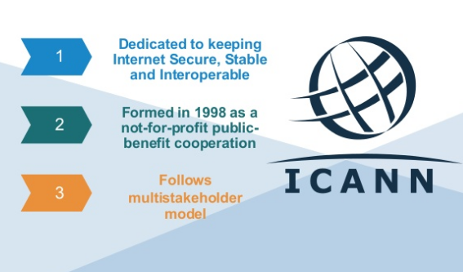
Internet Corporation for Assigned Names and Numbers

Slide 35
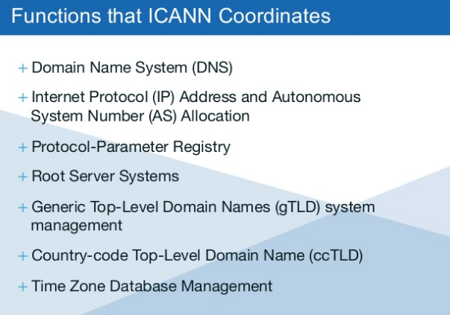
Internet Corporation for Assigned Names and Numbers

Slide 36
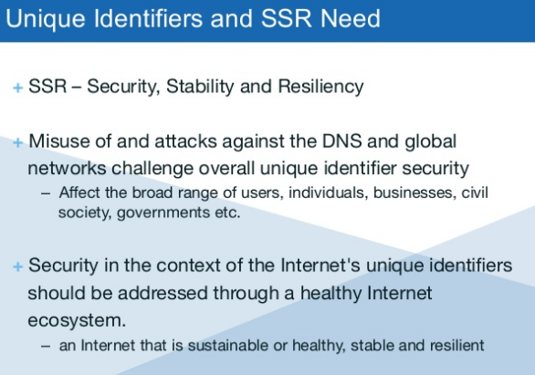
Internet Corporation for Assigned Names and Numbers

Slide 37
Internet Corporation for Assigned Names and Numbers

Slide 38
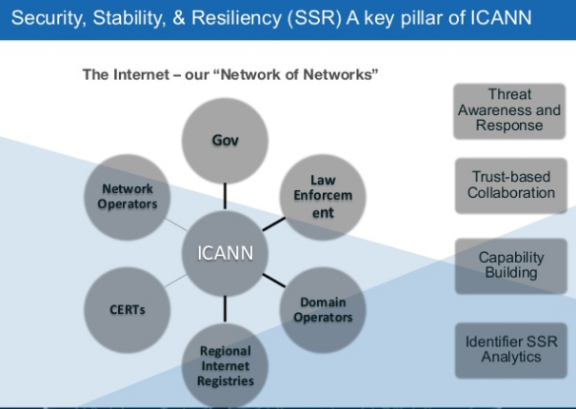
Internet Corporation for Assigned Names and Numbers

Slide 39
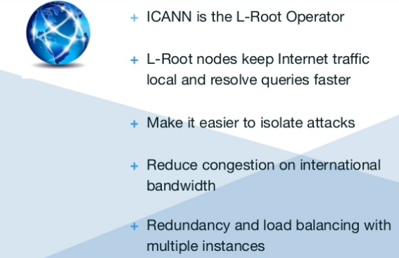
Internet Corporation for Assigned Names and Numbers

Slide 40
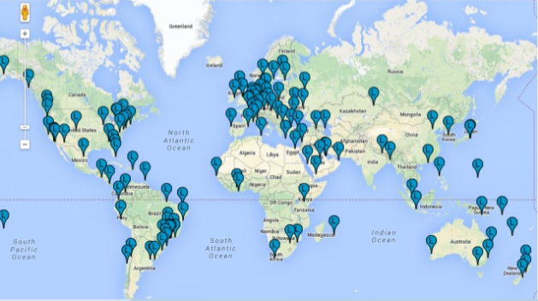
Internet Corporation for Assigned Names and Numbers

Slide 41
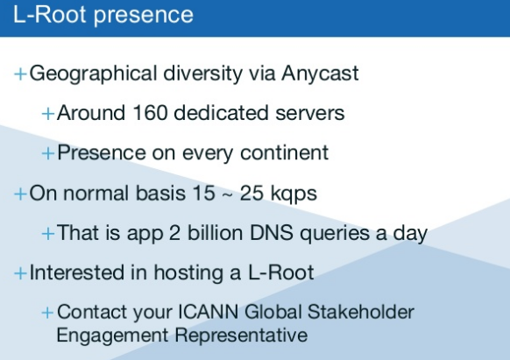
Internet Corporation for Assigned Names and Numbers

Slide 42
Internet Corporation for Assigned Names and Numbers
Problems with ICANN:
Strong influence from the US Department of Commerce (DoC)
Introduction of .suck domain
Privileging of trademark holders over all other possible users of trademarked terms in domain names
Controversial Dispute Resolution Process

Slide 43
‘Sucks’ Domains
‘Sucks’ Domains
It is popular for those with a grievance against an organization to register the organization's trading name with ‘sucks’ appended.
Could this be official site of the company? Judge may need to decide
There have been reverse domain-name hijacking attempts made on such registrations

Slide 44
Do Trademarks Matter in Domain Names or in URLs?

Slide 45
Trademarks
Trademark - This is the ‘ownership’ of, and right to use certain words and phrases in, domain names.
Trademark is a graphical sign (an icon, if you will) or, more recently, a word under which a particular person or organization is well known for their goods or services
Different organizations may use the same word or mark in different arenas provided there is no possibility of confusion between their products and services.

Slide 46
Trademarks in Domain Names
Many trademark holders were quite slow off the mark in seeing the potential benefits of owning their mark as a second-level domain in (principally) the .com gTLD (second or third-level in ccTLDs).
Unfortunately, being late to the party, quite a few large organizations found that their names (trademarked or not) had already been registered.
Many had been registered for legitimate purposes .
E.g. www.ty.com was registered for a man named “ty” but this was also the name of a company that sells toys
Some were registered simply as way to make easy money

Slide 47
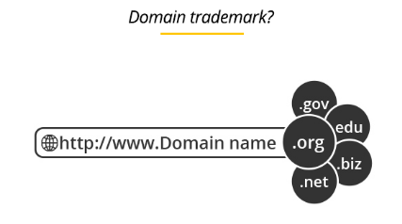
Trademarks in Domain Names

Slide 48
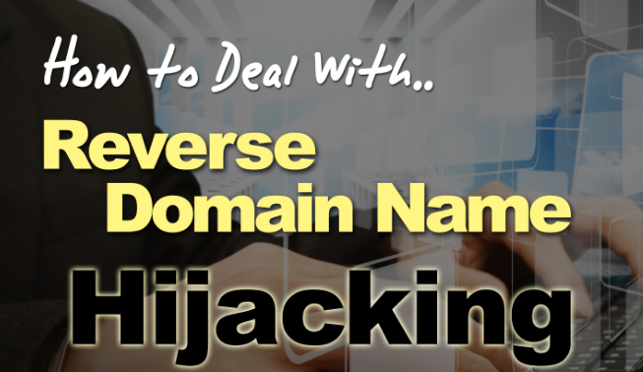
Trademarks in Domain Names

Slide 49
Trademarks in Domain Names
(Reverse) Domain Name Hijacking
Domain-Name Hijacking: Registration of well known names for the purposes of selling them for profit, or to redirect traffic looking for other organizations to one's own site.
E.g. Someone plans in advance that
proton.com.my would be a valuable www address name and purchases the domain name. Then the proton car company desires the web address and pays much $$$ for it

Slide 50
Trademarks in Domain Names
(Reverse) Domain Name Hijacking
Reverse Domain-Name Hijacking: attempts to use legal processes to grab a legitimate name that an organization simply wished it had the foresight to register first has become known as and is arguably as big a problem as domain-name hijacking
E.g. Joe Proton buys the domain name, not to make a profit upon sale, but rather, so that his family could use it for pictures and a blog. The proton car company sues Joe and wants money.

Slide 51
The Uniform Dispute Resolution Process
Dispute resolution policy (DRP): the method a domain registration organization uses to decide disputes that arise over ‘ownership’ of a domain.
In response to a growing number of lawsuits, which cost a time and money for the participants, and also in response to suits naming domain registration companies as co-defendants, the gTLD registrar NSI issued a ‘Domain Dispute Resolution Policy statement’
Statement pointed out that it did not have the resources to investigate all requests for domain registration ahead of time for possible infringement

Slide 52
The Uniform Dispute Resolution Process
As part of the new contract for registering a domain it required registrants to sign a contract avowing their intent and right to use the domain and gave NSI the right to remove or reallocate the domain registration when presented with a court order
The most controversial part of the policy was the privileging of trademark holders over all other possible users of trademarked terms in domain names.
This goes far beyond normal practice

Slide 53
The Uniform Dispute Resolution Process
For most trademarks there is nothing to stop use of the mark in other fields.
Only where trademarks have reached a particular level of notoriety (such as Rolls-Royce) are they sufficiently important to prevent use by anyone other than authorized operators in any sphere

Slide 54
The Uniform Dispute Resolution Process
The rulings by ICANN are inappropriately replacing trademark law precedence
Once ICANN entered the frame it also entered the trademark dispute and it commissioned the World Intellectual Property Organization (WIPO) to produce a proposal to solve the issue.
This would have been perfectly reasonable if WIPO were a democratic organization with the remit to ensure a fair and commonly applicable intellectual property regime

Slide 55
The Uniform Dispute Resolution Process
WIPO is principally a tool of intellectual property owners to expand and enforce their ideas about what should be protected and how
it is not a democratic representative body dedicated to the benefit of the people at large
WIPO Mission : any erosion of the existing protection should be prevented, and that both the acquisition of the protection and, once acquired, its enforcement, should be simpler, cheaper and more secure.

Slide 56
The Uniform Dispute Resolution Process
WIPO's initial plan was for it to be the (only) first-line arbiter of disputes and that its decision should be enforced until overturned by a court of law.
The final WIPO report restricted the scope of the new Uniform Dispute Resolution Procedure (UDRP) to the trademark issue in second-level domains.

Slide 57
The Nominet Dispute Resolution Process
Nominet (www.nominet.org.uk) is the UK domain name authority administering the .uk ccTLD.
Nominet is a membership organization: any person or organization with an ‘interest in the .uk domain system’ may become a member and the board are elected by the membership.
The Nominet Dispute Resolution Process (DRP) also privileges trademark holders over others with possible uses for a domain name.

Slide 58
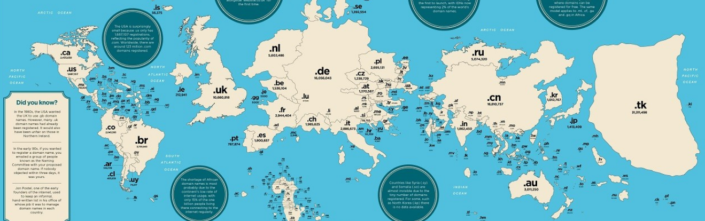
The Nominet Dispute Resolution Process

Slide 59
The Future of Internet Governance

Slide 60
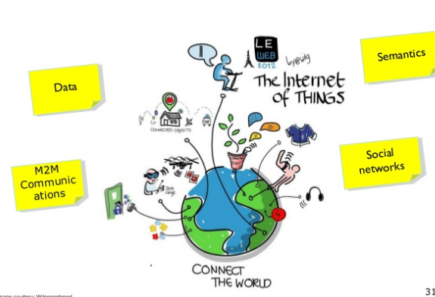
The Future of Internet Governance

Slide 61
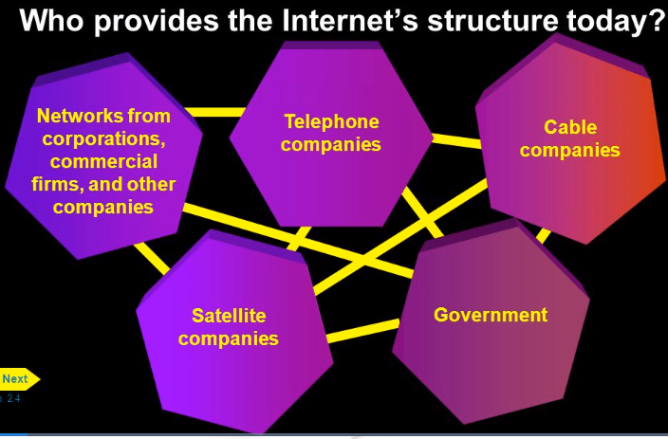
Today

Slide 62
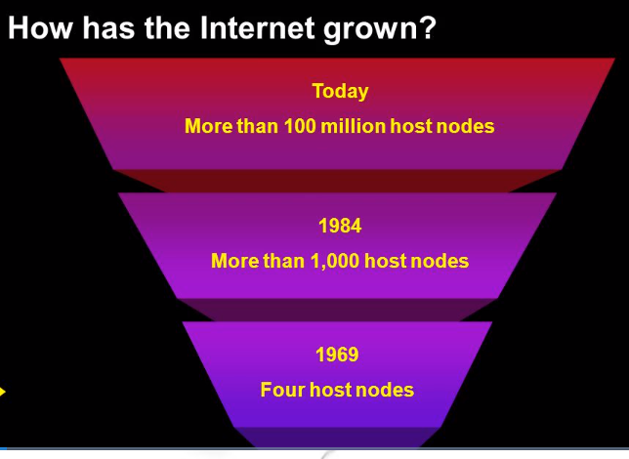
Today

Slide 63
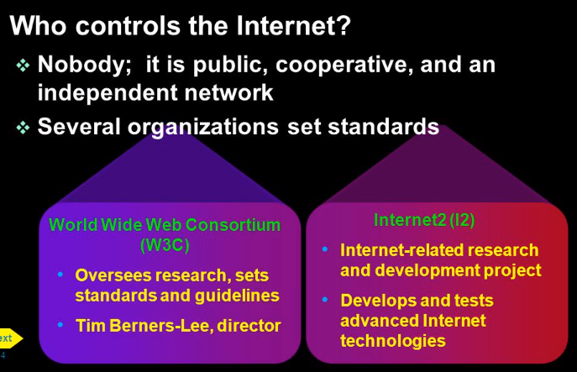
Today

Slide 64
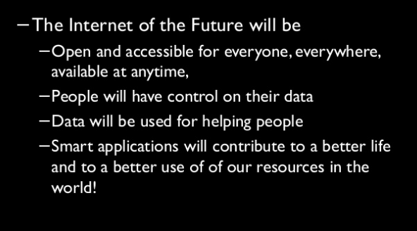
The Future of Internet Governance

Slide 65

The Future of Internet Governance

Slide 66
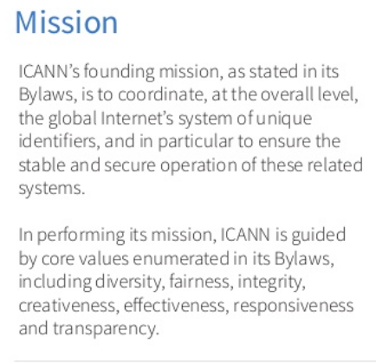
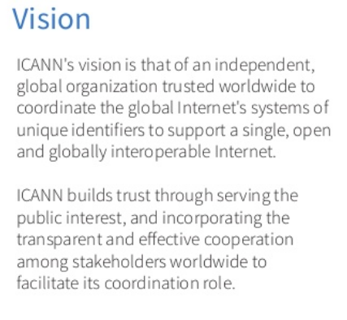
The Future of Internet Governance

Slide 67
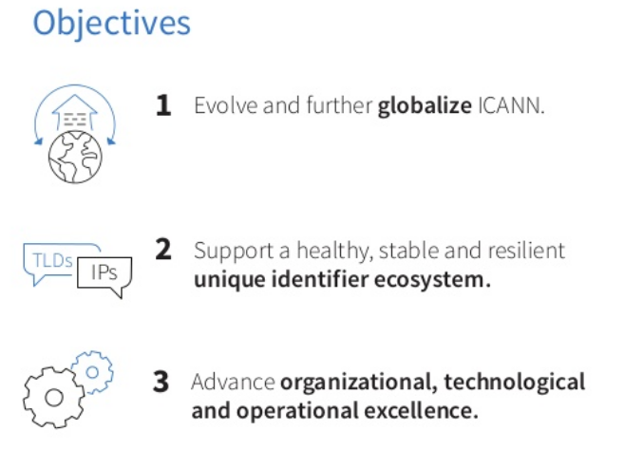
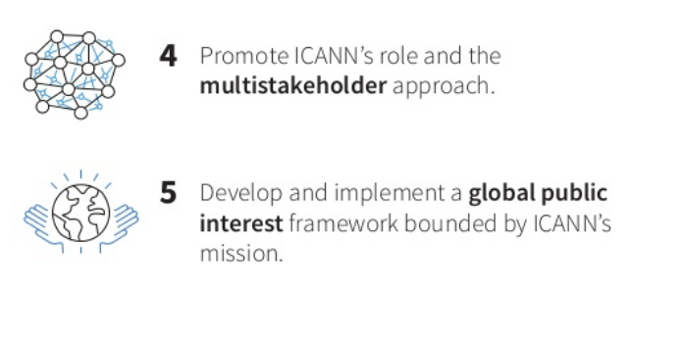
The Future of Internet Governance

Slide 68
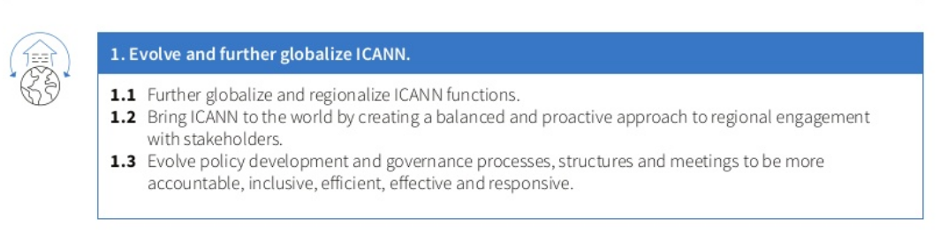
ICANN Strategic Plan 2016-2020

Slide 69
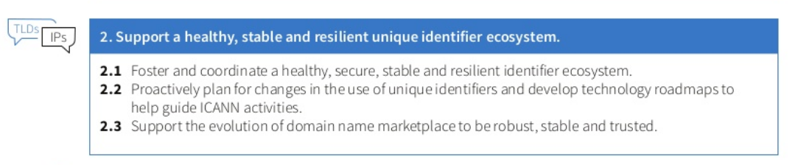
ICANN Strategic Plan 2016-2020

Slide 70
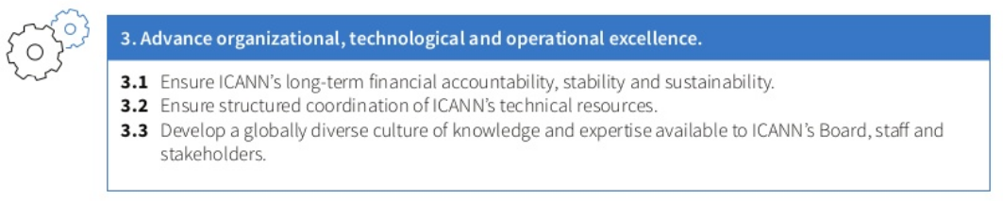
ICANN Strategic Plan 2016-2020

Slide 71
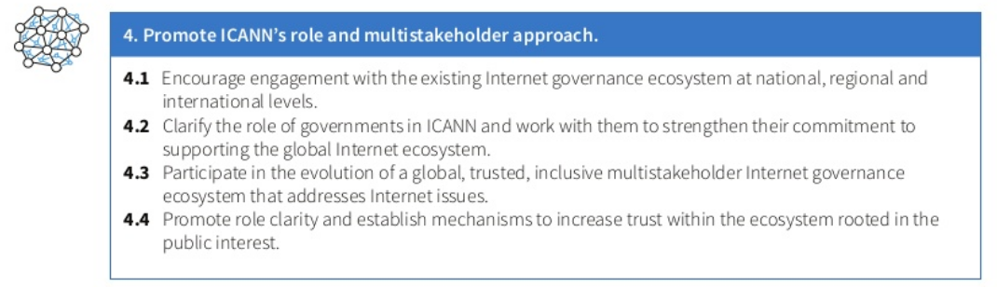
ICANN Strategic Plan 2016-2020

Slide 72
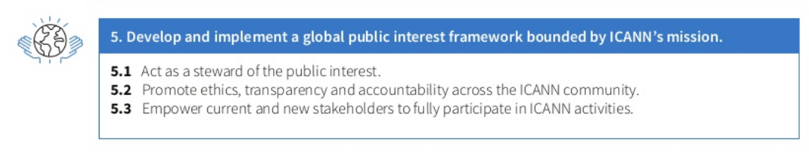
ICANN Strategic Plan 2016-2020

